Slide 1
Customer Churn Prediction with AutoML
Jonathan Agustin
Dina Shalaby
Paul Parks

Slide 2
Telco: Telecommunications Company
Business Problem: Customer Churning
Impact: Lost Revenue & Increased Marketing Costs
Goal: Build predictive model to identify at-risk customers
Benefits: Proactive Intervention, Targeted Retention, Resource Optimization, & Enhanced Customer Relationships

Slide 3
Telco Customer Churn Dataset
Description: Customer Metrics for 7043 customers
Demographics: gender, age, senior citizen status, marital status, dependents
Location: country, state, city, zip code, latitude, longitude
Population: zip code, population estimates
Services: service types, tenure, charges, contract type
Status: satisfaction score, churn label, churn score

Slide 4
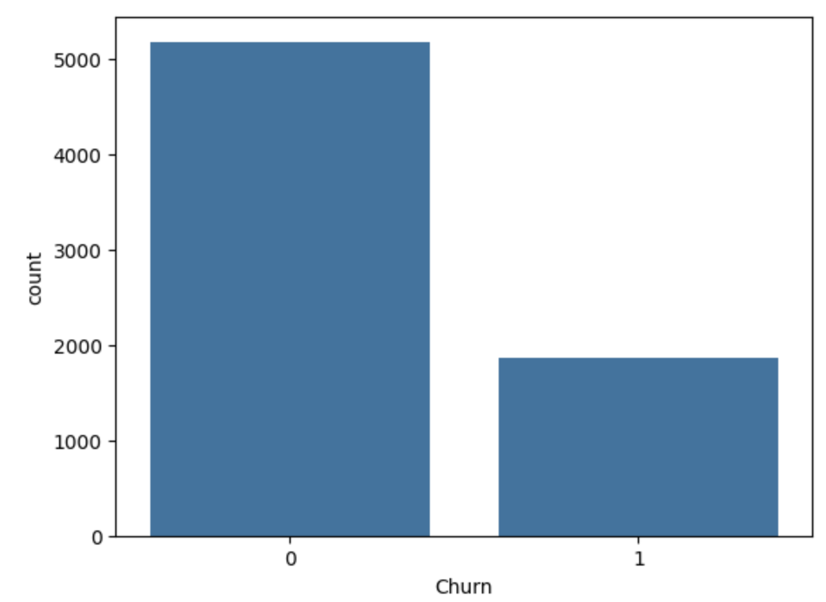
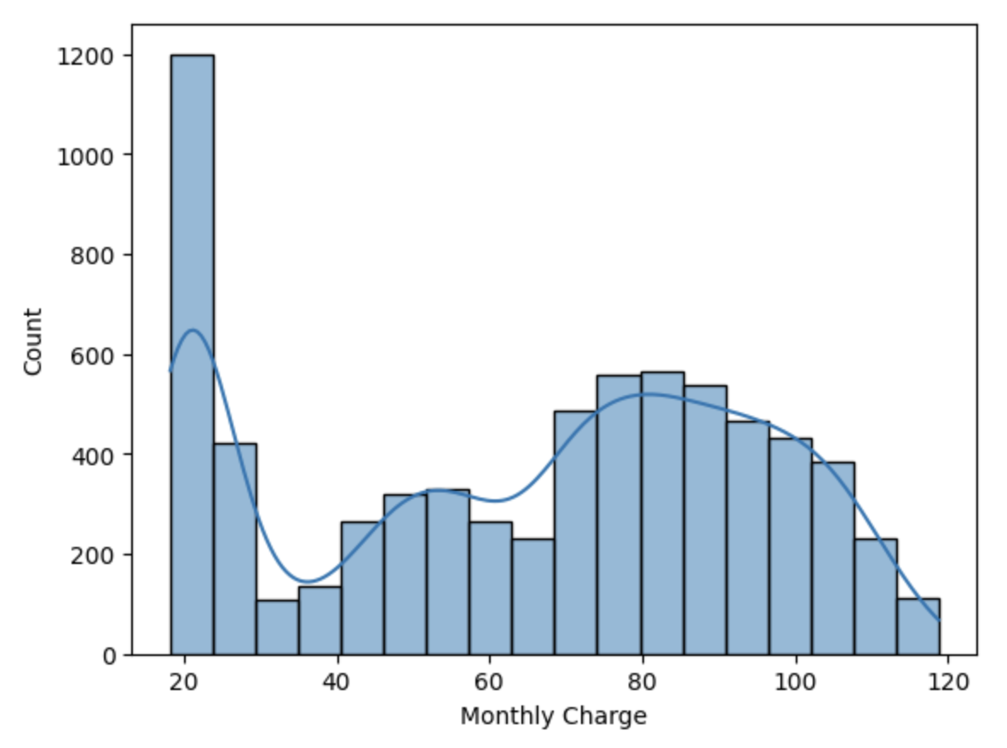
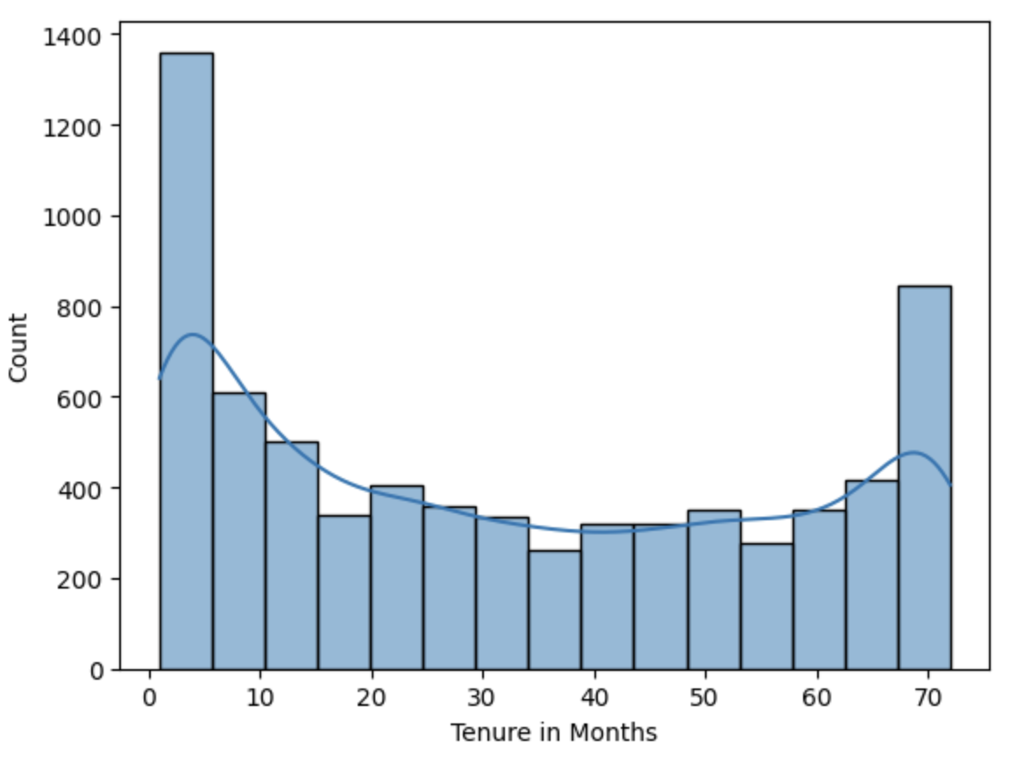

Slide 5
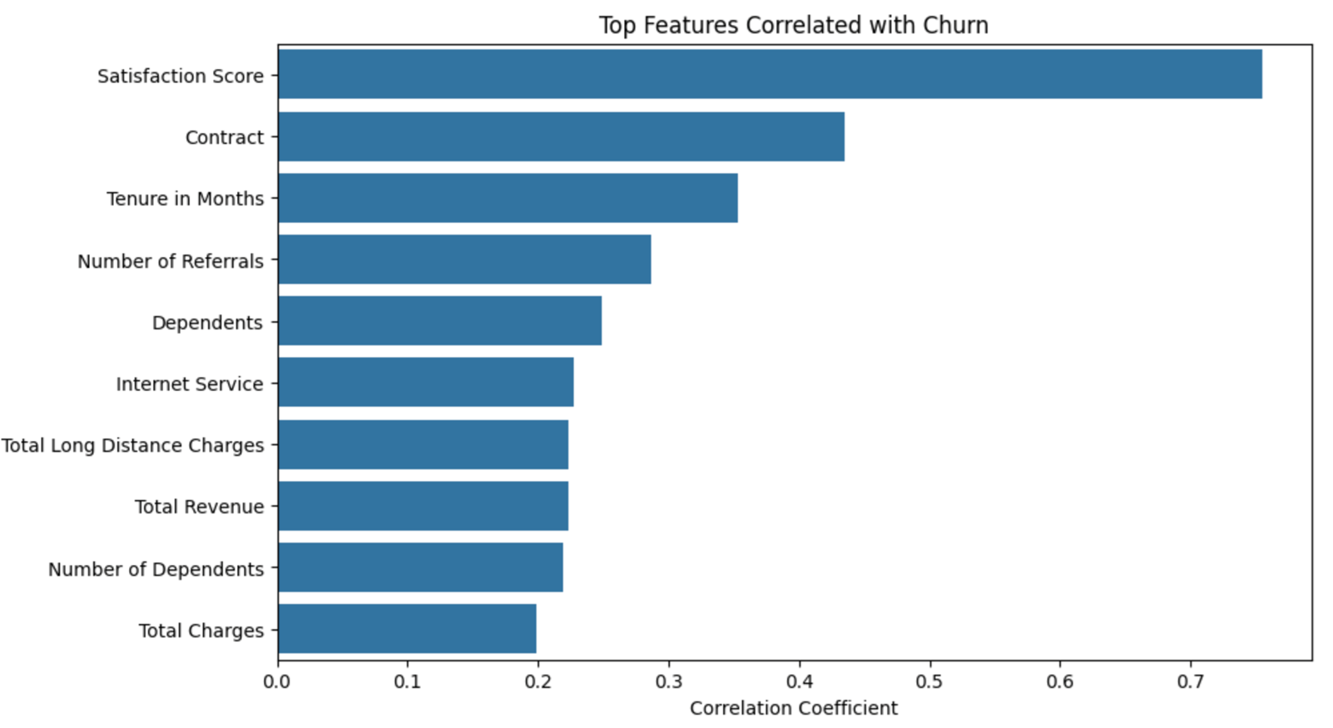

Slide 6
AutoGluon: The Winning Solution
AutoGluon is an AutoML Library Automatically selects best-performing model from a diverse set of algorithms. Best Model: Weighted Ensemble L3 Ensemble model Combined strengths of multiple models

Slide 7
Best Model: Weighted Ensemble L3
ROC AUC | Accuracy | Precision | Recall | F1 Score | MCC
0.995 | 0.9411 | 0.875 | 0.9098 | 0.8921 | 0.9154

Slide 8
Alternative Solutions
Decision Tree Classifier
XGBoost Classifier
Deep Neural Network

Slide 9
Results
Model | Accuracy | Precision | Recall | F1 Score
Decision Tree | 0.9411 | 0.875 | 0.9098 | 0.8921
Deep Learning (MLP) | 0.9489 | 0.9155 | 0.8912 | 0.9032
XGBoost | 0.9581 | 0.9517 | 0.8886 | 0.9191

Slide 10
Ethical, Business, & Regulatory Risks
Ethics: Bias/Fairness & Privacy Business: Recall & Proactive Engagement
Regulatory: Cybersecurity & Data Governance

Slide 11
Recommendations
Proactive Retention Personalized Offers Enhanced Support Monitor Feedback Targeted Campaigns Contract Optimizations

Slide 12
Conclusion & Accomplishments Built Predictive Customer Churn Model + Business Recommendations ↓ Churn + ↑ Customer Relationships = Boost Profitability

